Slide 1
Corporate Overview

Slide 2

Your Drug Development Partner
Two Continents-One System
High Technical Expertise
Excellent Quality Record- GLP, GCP and GMP
State of the Art Facilities and Equipment
Comprehensive Suite of Drug Development Services
Agrochemical Services

Slide 3
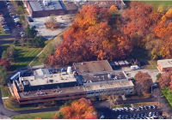



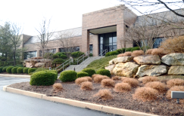
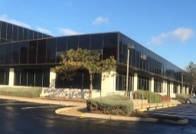
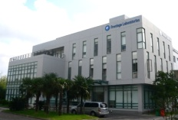
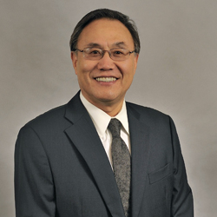
History
17 Years of Scientific Expertise and Quality
Concord Biosciences Preclinical and Agrochemical Acquired in Ohio
Sister CDMO, Frontida Acquired in Philadelphia, PA
Acquired Data Management and Biostats Services
Strategic
Investment
Agreement
With Tigermed
2018
2016
Expanded & Relocated HQ to Exton, PA
2015
Acquired Phase I Clinical Operations
Over 500 Employees in U.S. and China
2014
Opened Shanghai, China Office
2012
Company Founded By
Dr. Song Li
2008
2006
2001

Slide 4
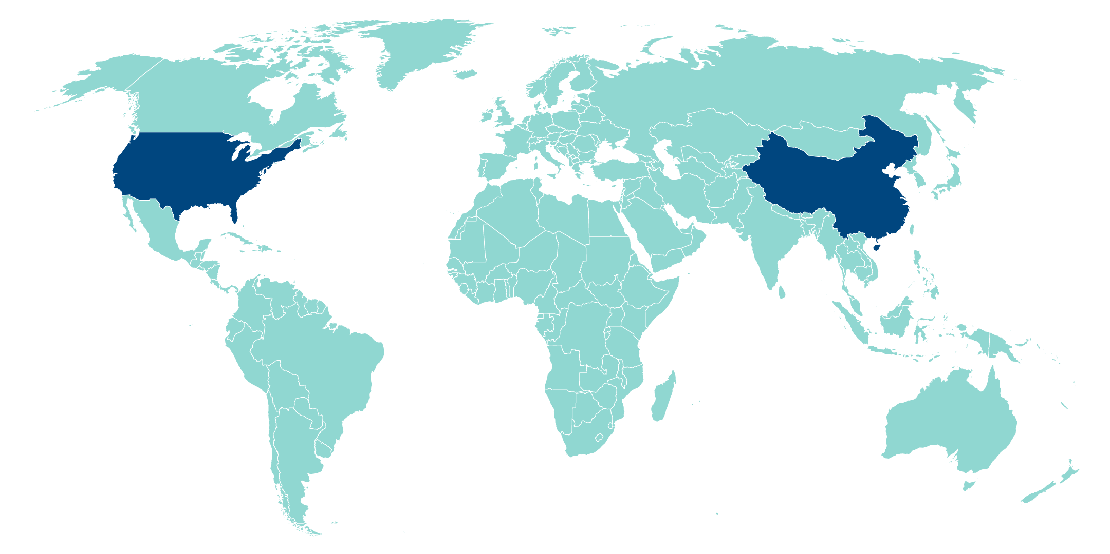

Two Continents, One System
Hospital-based Clinical Units
Hospital-based Clinical Units
Relations with 18 hospital including 6 early phase clinical facilities with >250 beds
Safety & Toxicology, DMPK, Bioanalytical, Agrochemical
66 staff
43 animal rooms
90,000 sq. ft.
USA
CHINA
Headquarters Bioanalytical, DMPK
Exton, PA
~88 staff in US, majority of scientists Hold advanced degrees
CMC Services
Exton, PA
200 clients
200 compounds
380 GMP batches
Bioanalytical Services
Shanghai
>26,000 sqf facilities located in Shanghai and Suzhou
>50 scientists; >70% have advanced degrees
CMC Services
Suzhou
• >30,000 sq. ft. facilities located in Suzhou
>40 Scientists; >70% have advanced degrees
160-Bed Facility
Secaucus, NJ
Early-Phase Clinical
36,000 sq. ft.
Data Management and Biometrics
Somerset, NJ
BDM Consulting
312 employees in the U.S.
176 scientific and technical support staff
196 employees in China
152 scientific and technical support staff

Slide 5

Our Investment Highlights
Value We Bring to Our Clients
Well positioned in the world’s two largest pharmaceutical markets
2
1
Proven ability to deliver value-add technical expertise
Highly experienced and professional management team
3
6
Effective quality management systems and strong track record of regulatory inspections
4
Strong track record of efficiency and flexibility
Diverse and growing customer base with increasing customer retention
5

Slide 6

Well positioned in the world’s two largest pharmaceutical markets
1
Well Positioned in the World’s Two Largest Pharmaceutical Markets
Global pharmaceutical CRO market is growing rapidly driven by a series of secular upward trends
Frontage is well positioned to capitalize on the robust industry growth
Increasing R&D Spending by global pharmaceutical companies
Global pharmaceutical CRO market size
(US$ bn)
CAGR 5.7%
  Integrated service offering throughout the drug discovery and development process
    Also collaborates with our controlling shareholder Tigermed Group to offer a comprehensive solution for clinical trial support in China, from Phases I through IV
  “Two Countries, One System” approach assures customers the same quality standards, operating procedures and systems in both China and US
    Provides a detailed and highly experienced understanding of the regulations and requirements for drug discovery and development in both countries
    Galvanize our strengths by sharing technical expertise and personnel in both countries
    “Partner of choice” for companies with multi-national requirements or companies that need support for parallel submissions with the US FDA and China FDA
  Value-add partner focusing on solving customers’ most significant and complex drug discovery and development challenges
(US$ bn)
CAGR 4.9%
Increasing R&D Outsourcing Ratio of Global Pharmaceutical Companies
US pharmaceutical CRO market size
CAGR 9.9%
CAGR 8.9%
(US$ bn)
Favorable Regulatory Environment
China pharmaceutical CRO market size
Encouraging policies on innovation and regulatory reform in China increase the demand for high quality CROs
  Accelerating review and approval process encouraging innovation
  Consistency Evaluation of Generic Drugs stimulates the demand for bioequivalence studies
  Encouraging policies on imported novel drugs to China market
(US$ bn)
CAGR 24.4%
CAGR 27.7%
____________________
Source: Frost & Sullivan

Slide 7



Proven ability to deliver value-add technical expertise
2
Proven Ability to Deliver Value-Add Technical Expertise
Focusing on Technical Excellence
Deep Pool of Talented & Highly Qualified Scientists
Recognition from Regulatory Authorities
World-class Facilities & Equipment
Able to understand and solve complex scientific challenges, i.e., drug formulation, data interpretation and bio-analysis
Committed to providing rigorous scientific expertise assuring the highest quality and compliance for each project
Facilitate strong and long term partnerships and strategic relationships with our customers built upon our scientific knowledge base, technical expertise and reputation for high quality services
Majority of our scientists hold advanced degrees, including PhDs, MDs or Master’s degrees
Certain scientists have expertise across a range of disciplines, enabling them to perform and manage a wide variety of tasks across our various business units
Our leading technical expertise has been recognized by authoritative regulatory institutions
We have collaborated with staff of the US FDA on certain publications
Also received accolades in China in recognition of our quality management
Each of our facilities is equipped with state-of-the-art equipment, including over 80 mass spectrometers across our facilities and high performance chromatography systems
Aim for our facilities to remain at the forefront of the global pharmaceutical research, analytical and development standards
Ranked as one of the Top Ten CROs by the Journal of Medical Field (2012)
A value-add partner with a focus on solving our customers’ most significant and complex drug discovery and development challenges

Slide 8
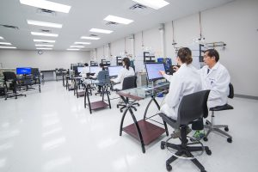
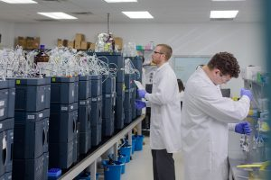
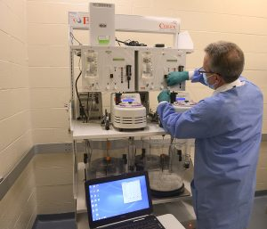
Effective quality systems and strong track record of regulatory inspections
Effective Quality Systems and Strong Track Record of Regulatory Inspections
3
Strong Track Record of Successful Regulatory Inspections …
… Backed by an Effective Quality System
Our facilities have successfully undergone inspections by the US FDA, the China FDA and Health Canada on numerous occasions
Have also been inspected by the US EPA, the US Drug Enforcement Agency (“DEA”), the World Health Organization (“WHO”) and the US Nuclear Regulatory Commission (“NRC”)
In-house quality control and quality assurance programs to ensure consistently meeting the high industry standards and regulatory requirements
  Quality control team overseeing various business teams
  Independent quality assurance team supervising the implementation of our quality strategies in relation to consumables, deliverables and equipment
“Two Countries, One System” approach supports our effective quality system
  Assures our customers the same quality standards, operating procedures, setup and systems in China as in the U.S.
  China business received ISO 9001 Quality Management System Certification from the Beijing ZhongDaHuaYuan in 2016

Slide 9




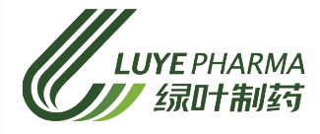
Diverse and growing customer base with increasing customer retention
4
Diverse and Growing Customer Base with Increasing
Customer Retention
Diverse Customer Base
Selected Key Customers
2017 Revenue by Segment
2017 Revenue by Customer Location ⁽¹⁾
(US$ millions)
(US$ millions)
9.6
4.1
8.4
35.5
22.6
16.7
43.6
Solid and Expanding Customer Base
Number of Customers
Revenue from Top 5 Customers
(US$ millions)
High visibility of future growth
  Contracted future revenue of approximately US$68.72 million ⁽²⁾
Involvement in first-to-market generic drugs
  China’s first generic version of a drug approved by the US FDA and subsequent approval by the China FDA through the consistency evaluation waiver program
____________________
Notes:
Revenue by the customers’ respective country / region of operation
As at March 31, 2018

Slide 10





Strong track record of efficiency and flexibility
5
Strong Track Record of Efficiency and Flexibility
Agile project management
Our research scientists regularly act as project managers and interact with customers directly to generate customer-oriented solutions
Efficient Delivery with Flexibility
Able to deliver on time and maintain flexibility to provide accelerated delivery to meet customer need
Top notch scientific team
Our scientific team are a group of highly qualified individuals with a depth of knowledge, high level of data literacy and solution-driven thinking

Slide 11
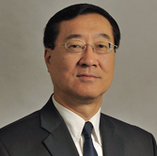
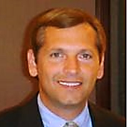


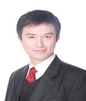
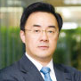



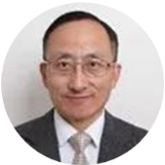
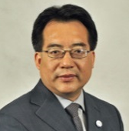
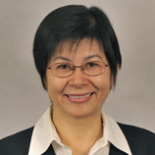
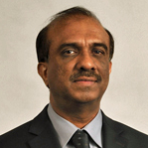






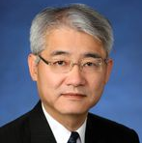
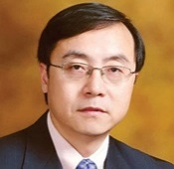





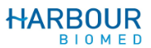

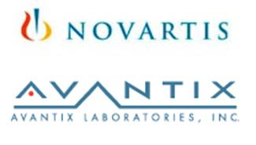

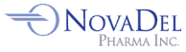




Highly experienced and professional management team
6
Highly Experienced and Professional Management Team
Highly Experienced Senior Management Team
Reputable Board Members Offering Longstanding Support
Song Li, Ph.D.
Founder, Honorary Chairman
(CEO of Frontage Laboratories, Inc.)
Zhihe Li, Ph.D., M.D.
Chief Executive Officer
Hugh M. Davis, Ph.D.
Chief Business Officer
Zhihe Li, Ph.D., M.D.
Executive Director
Dr. Li, Founder and CEO of Frontage Laboratories, Inc., has been awarded the Entrepreneur Of The Year Award for 2018 and 2018 Enterprise Awards Health care CEO of the Year. Dr. Li received his Ph.D. in Analytical Chemistry from McGill University in Canada
Dr. Li is responsible for corporate strategies and global operations. He has over 20 years experience in the pharmaceutical industry and he received his Ph.D. in Pathology from McGill University in Canada
Dr. Davis oversees all Business Development, Sales, Marketing and Strategic Partnerships. He has over 30 years of experience in pharmaceutical industry and received his Ph.D. in Biochemistry from Villanova University
Jun Gao
Non- Executive Director
Yifan Li
Independent
Non- Executive Director
Tianyi Zhang, Ph.D., MBA
Executive Vice President,
Head of China Business
Zhongping (John) Lin, Ph.D.
Executive Vice President,
Bioanalytical and Biologics
Services
Dongmei Wang, Ph.D.
Executive Vice President,
General Manager,
CMC Services
Abdul Mutlib, Ph.D.
Executive Vice President,
DMPK Services
Over 20 years experience in drug analysis; published over 60 papers and reports
Over 20 years experience;
contribution to over 40 publications and 8 book chapters
More than 22 years pharmaceutical development experience
Over 20 years experience in drug metabolism and analytical chemistry
Erhfei Liu
Independent
Non- Executive Director
Jingsong Wang, Ph.D.
Independent
Non- Executive Director

Slide 12
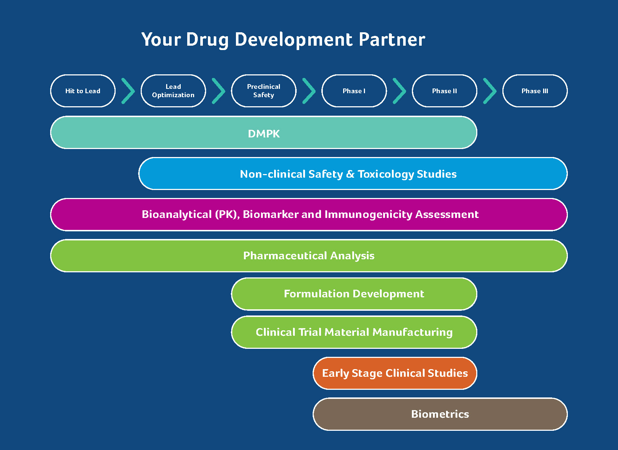
Technical Capability & Expertise in Drug Development
Agrochemical
70% of our scientists hold advanced degrees, majority with industry experience

Slide 13
Unparalleled Compliance and Quality
Service Area (Location) | # Facility Inspections | Inspection Years
BIO-US/ CMC-US (HQ, Exton, PA) | 12/2 | 2004-2018
CMC-US (Exton, PA) | 8 | 2006-2017
CRC-US (Hackensack, NJ) | 4 | 2009-2014
CRC-US (Secaucus, NJ) | 1 | 2016
BIO-CH/ CMC-CH (CH HQ, Shanghai, China) | 2/1 | 2013
CRC-CH (Zhengzhou, China) | 1 | 2013
CRC-CH (Changchun, China) | 1 | 2015
CMC-CH (Suzhou, China) | 1 | 2016
Total US FDA Facility Inspections | 33 | 2004-2018
Our facilities and processes undergo routine audits and inspections from sponsors and regulatory authorities, including US EPA, US FDA, Health Canada, WHO
Operates under strict adherence to applicable ICH and US FDA GxP regulations and guidance
Compliant with internal standard operating GxP procedures (SOP), and world health authority guidance.
Bioanalytical CLIA Certified, AAALAC Accredited and OLAW Assurance

Slide 14
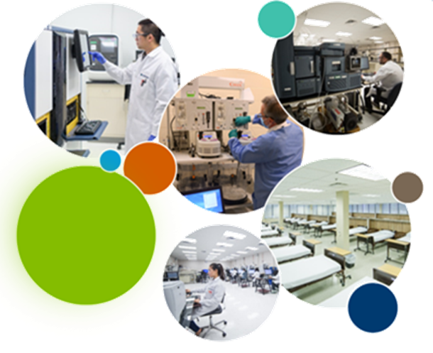
Instrumentation and Facilities
65+ LC/MS/MS instruments for bioanalytical quantification and characterization of small and large molecules.
Frontage is first to offer ultra-sensitive biomarker quantification with Quanterix SimoaTM
Magpix Luminex and Ella Protein Simple instrument platforms enables efficient screening of multiple biomarkers and isolation of a single critical biomarker candidate from a large pool of analytes
Culex System promotes reduction of animal usage by serial bleeding of mice for pharmacokinetic studies
Maurice System enables separation of charge/size variants in a stable pH gradient established by ampholytes in a capillary, and detection by whole column imaging with UV absorbance or native fluorescence
160-bed phase I clinic located less than 7 miles from NYC, with access to a large diverse population of volunteers
$40MM invested in state-of-the-art instrumentation and facilities

Slide 15
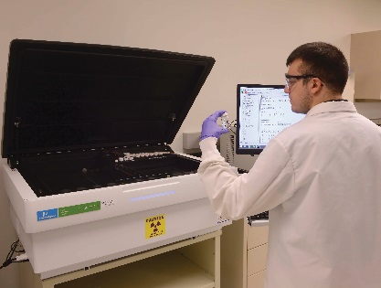
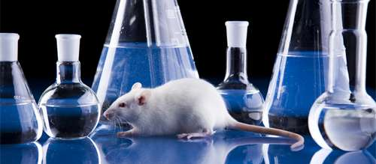
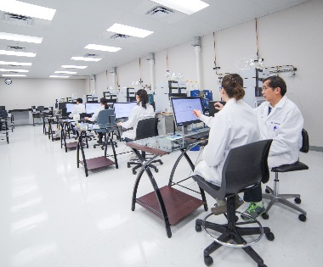
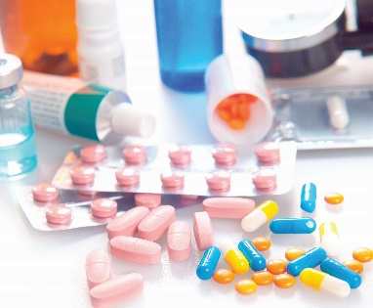
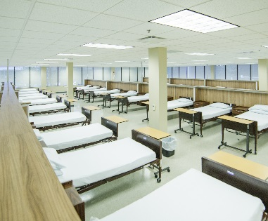

Drug Development Services
DMPK
SAFETY &
TOXICOLOGY
BIOANALYTICAL
CMC
CLINICAL
BIOMETRICS
Rapid PK; In Vitro ADME
Mass Balance
Early Discovery to Late Development
Metabolite Identification
IND Enabling Studies
Regulatory/general toxicity
Safety pharmacology
Full clinical and anatomic pathology, ophthalmology, ECG
Post IND Service
GLP Analytical Support
Biomarker Services
Preclinical and Clinical Support
Global Bioanalytical Services (65+ LC-MS/MS)
Biologics Assay (Antibody Drug, ADC, Oligonucleotide)
Analytical Services
Formulation Development
CTM Manufacturing
GMP commercial stability
Small molecules & Biologics
IND & ANDA
Clinical Centers in US and China
Phase I: SAD, MAD, BA, BE, Food Effect, DDI
First to File Packages
CDISC-Compliant Datasets
Biostats and SAS Programming
Preclinical-Phase IV Development Support
EDC & Data Management

Slide 16
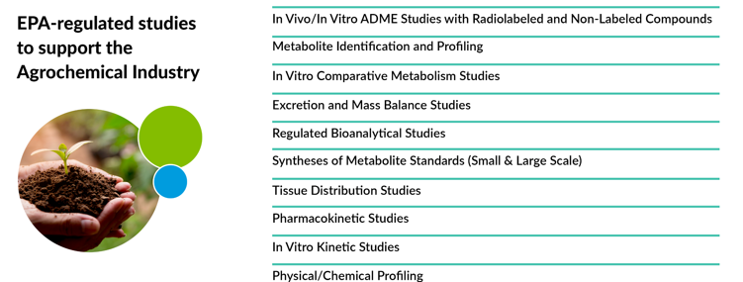
Agrochemical Services

Slide 17
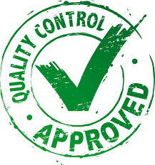
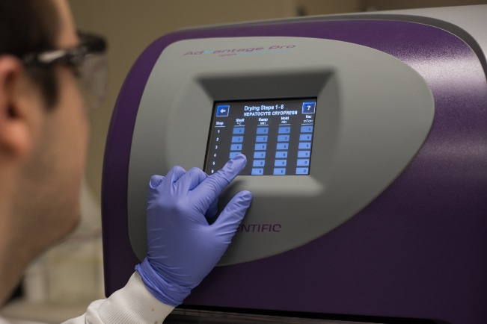
DMPK Services
Technical Expertise
25+ employees; cross-trained
Automation for Increased Precision and Efficiency
Advanced automation instrumentation for in vivo ADME, in vitro ADME
Rigorous Quality
Ability to provide scientific input to designs and interpretation of data to influence decision-making process
Average experience 10-15 years
Automation for in vivo PK studies minimizes animal usage/handling and accelerates study timelines while maintaining high quality data.
Standard operating procedures (SOPs)
Watson LIMS for sample inventory management
Temperature controls and ultra-low temperature freezers help preserve data quality and specimen integrity
All studies are conducted in accordance with FDA and EPA GLP, IACUC protocols, Nuclear Regulatory Commission and the Pennsylvania Bureau of Radiation Protection Regulations for radioactive materials.
Our current liquid handling platforms include Tecan and Tomtec

Slide 18


Preclinical Safety & Toxicology Services
Specialized Facilities
Compliance with GLP regulations
AAALAC accreditation
Scientific Expertise
Integrated program management oversight
Speed and Flexibility
Rapid project initiation
Board-Certified Toxicologists, Veterinarians and Pathologists
Experienced study directors and detail-oriented technicians
DEA licensed facility, regular inspections with all major regulatory bodies, excellent regulatory track record and reputation
Fast turnaround time
43 animal rooms
Integrated chemistry and biology services to accelerate your program
Full support labs (clinical pathology, histology, pharmacy) under one roof
Provantis (wireless data collection, 21 CFR 11 compliant)
Microchip animal identification
Rigorous quality management process embedded throughout the entire organization and process

Slide 19
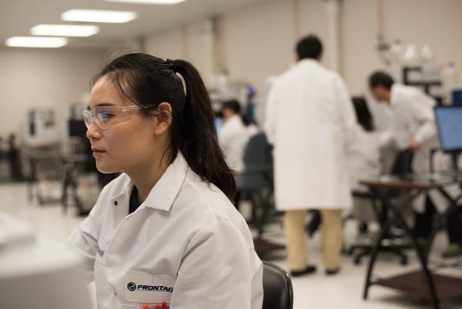

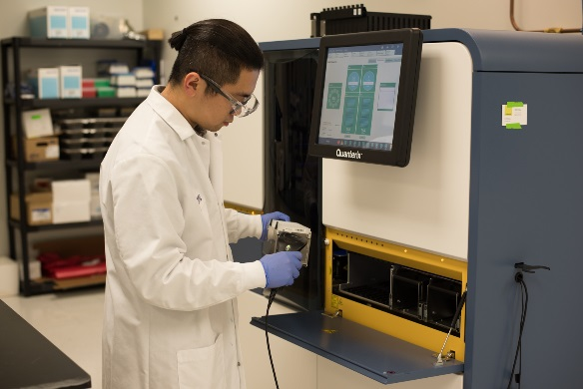
Bioanalytical Services
17 Years of Strong Scientific Expertise
70% of staff have advanced degrees
Senior scientists average 10 – 15 years in complex drug development
Outstanding Quality and Compliance
Outstanding audit history with more than 30 inspections by the FDA, WHO and Health Canada.
Compliant with internal standard operating procedures (SOP), Good Laboratory Practice (GLP) and world health authority guidance.
Wide Range of Technology Platforms
High Capacity with over 65 LC/MS/MS
Ultra-sensitive detection capabilities (femtogram/mL)
Single and multiplex analysis in various disease categories
Small molecule, biologics and biomarkers expertise
CLIA Certified Laboratory
Many come from leading Pharmaceutical companies
Multiple Immunoassay platforms
200,000 -500,000+ Samples (Annual Capacity)

Slide 20
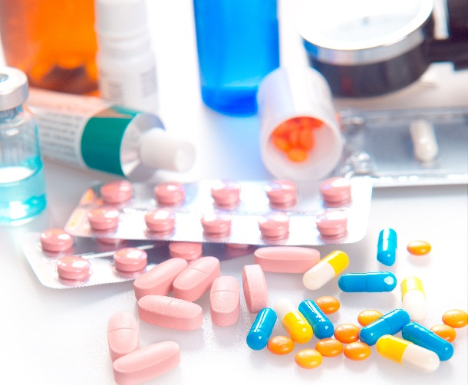
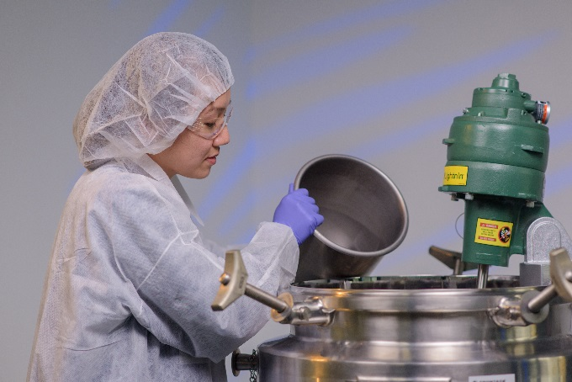
CMC (Chemistry, Manufacturing and Control)
Services
Capacity & Expertise
220 Clients -- 220 Compounds -- >450 GMP Batches
Outstanding Quality and Compliance
Our facilities and processes undergo routine audits and inspections from sponsors and regulatory authorities. including US EPA, US FDA, Health Canada, WHO
Designed to Provide Flexibility
Facilities engineered to offer a variety of dosage forms including OSD, topical, sterile solution & lyophilized powder
Operates under strict adherence to ICH and US FDA GMP guidelines
Ability to handle highly potent compounds and DEA-controlled substances
Over 1,500 methods conducted, including method development/method validation and method transfer
Seven (7) FDA inspections in past 8 years: no 483 for lab operations
Inspected by Health Canada & European Union Qualified Person (EUQP)

Slide 21
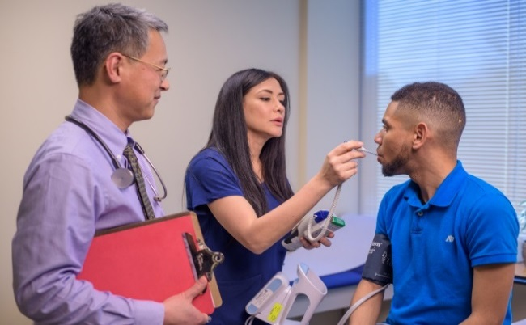
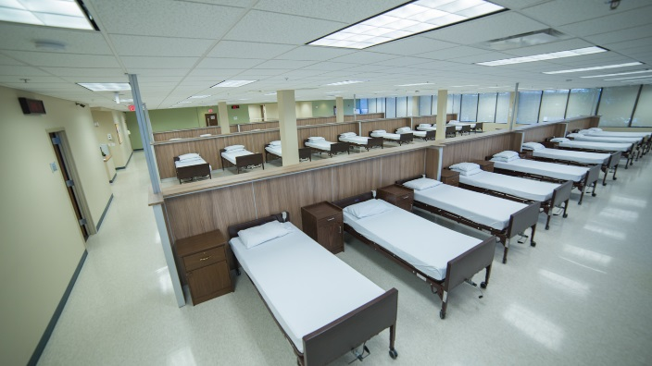

Clinical Services
Over 20 years of Early Stage Clinical Experience
Experience in execution of comprehensive Phase I-IIa studies
Experience in broad range of study types
Expertise in wide variety of delivery systems
Purpose-Built Facility
Modern 36,000 sq. ft. facility
Multiple units with 160 beds
Secure limited-access pharmacy
Video monitoring and key card access
Rees monitoring on freezers
Back-up generator
Prime Geographic Location
Less than 7 miles from NYC
Access to over 29.5 million potential volunteers
Proximity to extensive mass transit and 2 major airports
Located near some of the leading medical facilities in the country
0.25 miles to local ER

Slide 22



Biometric Services
Extensive Experience
Biostatistics consultation and analyses by staff statisticians with more than 20 years of industry experience
Expertise in generation of CDISC-compliant datasets and supporting documents
Broad Service Offerings
Clinical development plans and study designs
Service Integration
Stand alone biometric services or fully integrated with Phase I clinic
Focus on communication
Phase I-III and post-marketing study support
Medical writing including protocol, ICF, SAP, DMP, and CSR
Pharmacokinetic consultation and analyses
Sample size estimations, randomization schedules and TLFs
Full Data Management services
Dedicated Project Manager assigned to each project

Slide 23




Hugh M. Davis, Ph.D.
Chief Business Officer
Mobile: 484-431-8137
Office: 484-282-7658
hdavis@frontagelab.com
www.frontagelab.com

